Slide 1
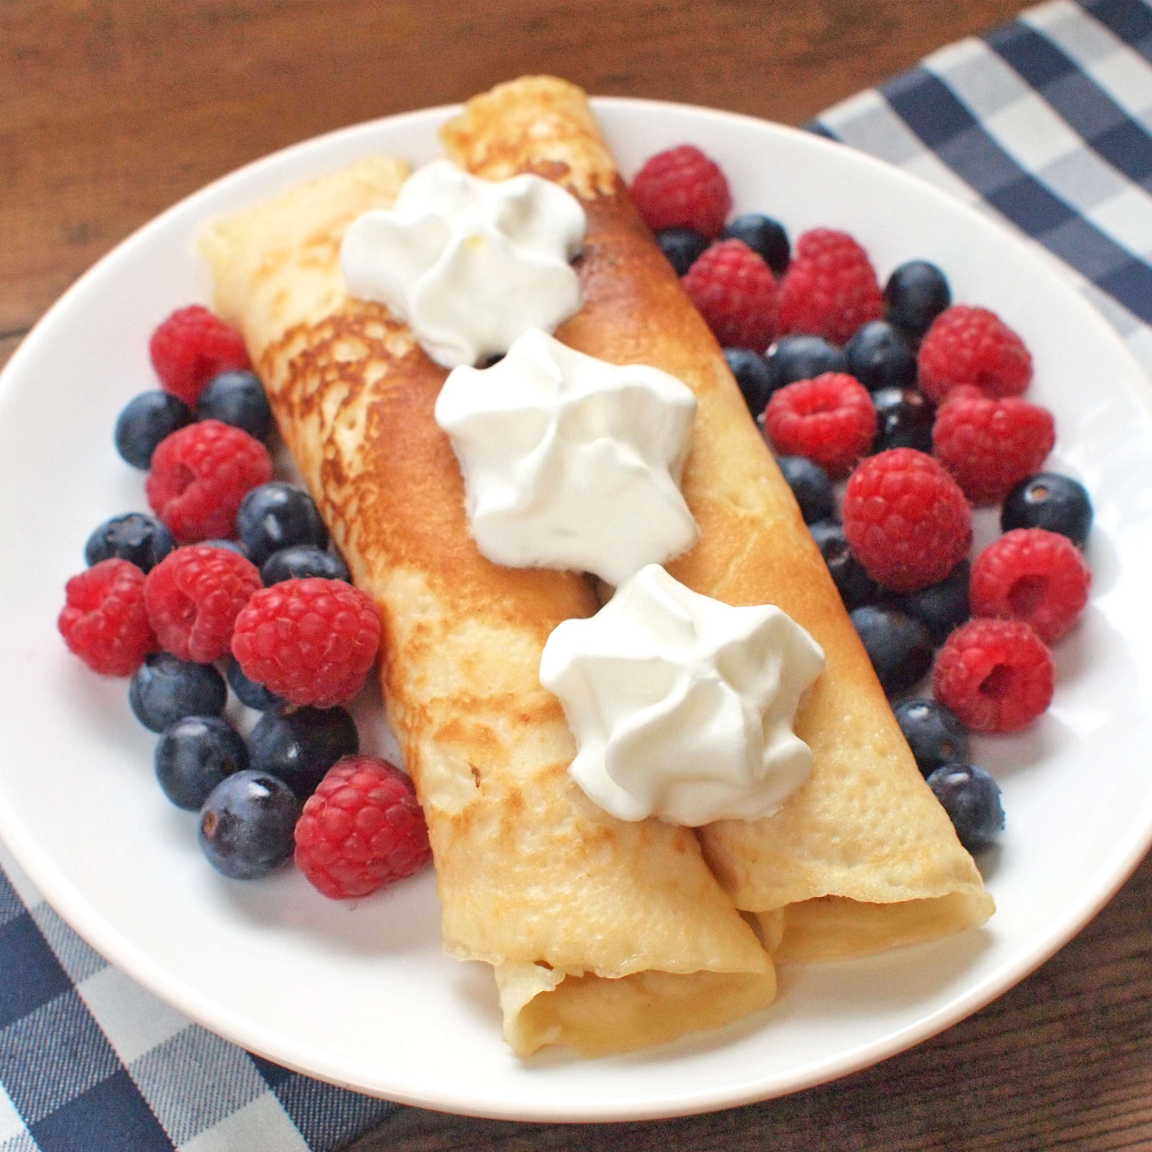
Pancakes recipe

Slide 2
Equipment:
Whisk
Pan
Bowl
Kitchen
Cooker
ladle

Slide 3
ingredients:
jam
oil
sugar
milk
salt
flour
eggs
nutella
whipped cream

Slide 4
MEMBERS
Jaroslav
Matyáš
Marek
Patrik
Adam

